Slide 1
Bank Telemarketing outcomes
Selina Matthews, Shaun Xu, Haodong Zhang

Slide 2
Outline
Introduction
Project specifics
Conclusion

Slide 3
INTRODUCTION
Our project looks at the efficacy of a direct marketing campaign by a Portuguese bank
According to a report issued by Deloitte in 2019, the increase in the use of AI and machine learning in marketing increased by 27% from 2018 to the time of the report.
This is also predicted to increase steadily over the coming years

Slide 4
The dataset
Our dataset features over 4100 rows of data on 21 aspects of the target clients
Attempting to find whether the direct marketing technique worked on the clients, with an outcome of either accepting or rejecting the long-term deposit

Slide 5
Libraries used
SQLite
Used to house our data, as we have more familiarity with it
Scikit-Learn
Used to split our data into a test and training set, as well as fitting and scaling our data
Pandas
We used this to process and clean our data
Used Keras to create a neural network
Tensorflow

Slide 6
Steps
Prepare Dataset
Read dataset from csv file, analyze and clean the data.
Save to Sqlite databse
Splite Dataset
Splite data into features and target arrays.
Splite data into training and testing dataset.
Create standard scaler and scale the data.
Model Implementation
Define the deep neural net model and compile。
Train the model.
Evaluate the model using the test data.
Model Optimisation
Note every time evaluate result.
Change hidden layers and neurons numbers and run again.
Choose another activation function and rerun.

Slide 7
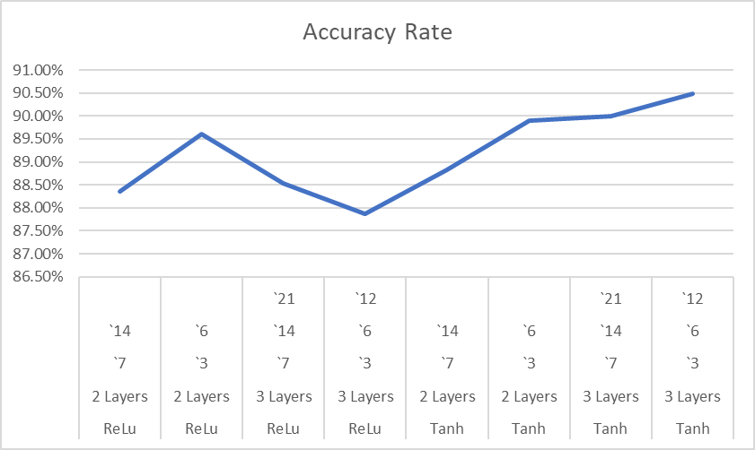
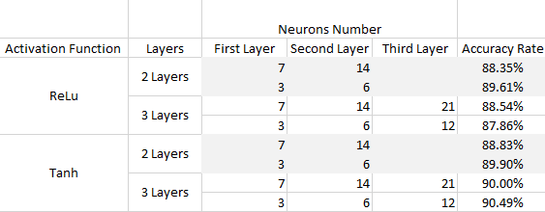
Visualisations/findings?
Difference Parameter
Chart of Accuracy Rate

Slide 8
Limitations
Potentially outdated
Time
Different consumer market
Dataset is based on a specific offer of a long-term deposit
Data is from one specific bank and may not reflect other markets
Data was collected from 2008 to 2013, and may not be applicable to current markets
Use case may not be relevant today, but it does show the potential for this type of model when based on updated data​​​
The project itself was scaled back in terms of scope dramatically,
We would have liked to do more with the data and create a more interactive experience with it.

Slide 9
In conclusion:
The neural network is greatful for this project, we got a accuracy more than 75%.
Choose the right activation function will increase the accuracy rate. In this dataset, Tanh is better than ReLU.
Sometimes, more hidden layers would be got a better accuracy rate. But we need to optimize one by one.

Slide 10
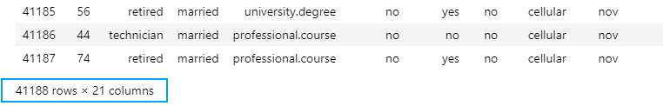
Discussion
We try to increase the dataset from 4119 to 41188 rows
Use the same Tanh activation function and 3 layers neural network.
The accuracy rate increase from 90.49% to 91.59%.
It seem to say, more data training, the prediction is more accurate.

Slide 11
THANK YOU
Data and Sources:
https://archive.ics.uci.edu/ml/datasets/Bank+Marketing
A data-driven approach to predict the success of bank telemarketing
https://libkey.io/libraries/591/articles/49822781/full-text-file?utm_source=api_309
https://www2.deloitte.com/content/dam/Deloitte/us/Documents/CMO/us-the-cmo-survey-fall-2019.pdf

